Slide 1
CS 5187: Vision and Image
Lecture 1-2
Image Filtering
Dr. Dapeng Oliver Wu
City University of Hong Kong
Department of Computer Science
Semester A, 2026/27

Slide 2

What is an image?

Slide 3
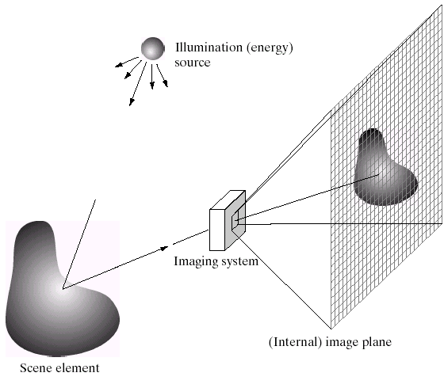
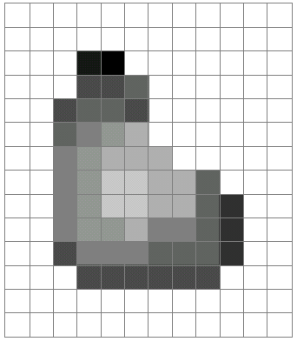
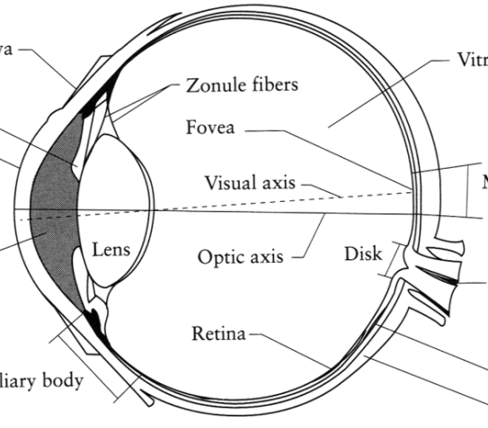
What is an image?
Digital Camera
We’ll focus on these in this course
Also image formation
The Eye
Source: A. Efros

Slide 4
What is an image?
A grid (matrix) of intensity values
(common to use one byte per value: 0 = black, 255 = white)
255 | 255 | 255 | 255 | 255 | 255 | 255 | 255 | 255 | 255 | 255 | 255
255 | 255 | 255 | 255 | 255 | 255 | 255 | 255 | 255 | 255 | 255 | 255
255 | 255 | 255 | 20 | 0 | 255 | 255 | 255 | 255 | 255 | 255 | 255
255 | 255 | 255 | 75 | 75 | 75 | 255 | 255 | 255 | 255 | 255 | 255
255 | 255 | 75 | 95 | 95 | 75 | 255 | 255 | 255 | 255 | 255 | 255
255 | 255 | 96 | 127 | 145 | 175 | 255 | 255 | 255 | 255 | 255 | 255
255 | 255 | 127 | 145 | 175 | 175 | 175 | 255 | 255 | 255 | 255 | 255
255 | 255 | 127 | 145 | 200 | 200 | 175 | 175 | 95 | 255 | 255 | 255
255 | 255 | 127 | 145 | 200 | 200 | 175 | 175 | 95 | 47 | 255 | 255
255 | 255 | 127 | 145 | 145 | 175 | 127 | 127 | 95 | 47 | 255 | 255
255 | 255 | 74 | 127 | 127 | 127 | 95 | 95 | 95 | 47 | 255 | 255
255 | 255 | 255 | 74 | 74 | 74 | 74 | 74 | 74 | 255 | 255 | 255
255 | 255 | 255 | 255 | 255 | 255 | 255 | 255 | 255 | 255 | 255 | 255
255 | 255 | 255 | 255 | 255 | 255 | 255 | 255 | 255 | 255 | 255 | 255
=

Slide 5
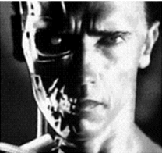
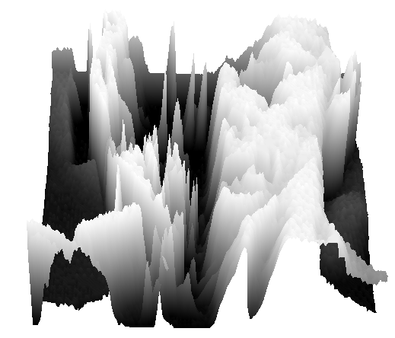
What is an image?
We can think of a (grayscale) image as a function, f, from R² to R:
  f (x,y) gives the intensity at position (x,y)
  A digital image is a discrete (sampled, quantized) version of this function
f (x, y)
x
y

Slide 6
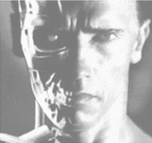
Image transformations
As with any function, we can apply operators to an image
We’ll talk about a special kind of operator, convolution (linear filtering)
  g (x,y) = f (x,y) + 20

Slide 7
Filters
Filtering
  Form a new (output) image whose pixel values are a function of the pixel values in the input image
Why?
  To get useful information from images
    E.g., extract edges or contours (to understand shape)
  To enhance the image
    E.g., to remove noise
    E.g., to sharpen or to “enhance image”

Slide 8
Image Processing problems
Image Restoration
  denoising
  deblurring
Image Compression
  JPEG, JPEG2000, MPEG..
Computing Field Properties
  optical flow
  disparity
Locating Structural Features
  corners
  edges

Slide 9
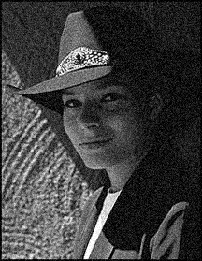
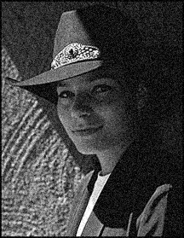

Question: Noise reduction
Given a camera and a still scene, how can you reduce noise?
Take lots of images and average them!
Can we do better than simple averaging?
Source: S. Seitz
Notes:
Answer: take lots of images, average them

Slide 10
Image filtering
Modify the pixels in an image based on some function of a local neighborhood of each pixel
10
5
3
Some function
4
5
1
7
1
1
7
Local image data
Modified image data

Slide 11
Linear filtering
One simple version of filtering: linear filtering (cross-correlation, convolution)
  Replace each pixel by a linear combination (a weighted sum) of its neighbors
The prescription for the linear combination is called the “kernel” (or “mask”, “filter”)
10
5
3
0
0
0
4
6
1
0
0.5
0
8
1
1
8
0
1
0.5
Local image data
kernel
Modified image data
Source: L. Zhang

Slide 12



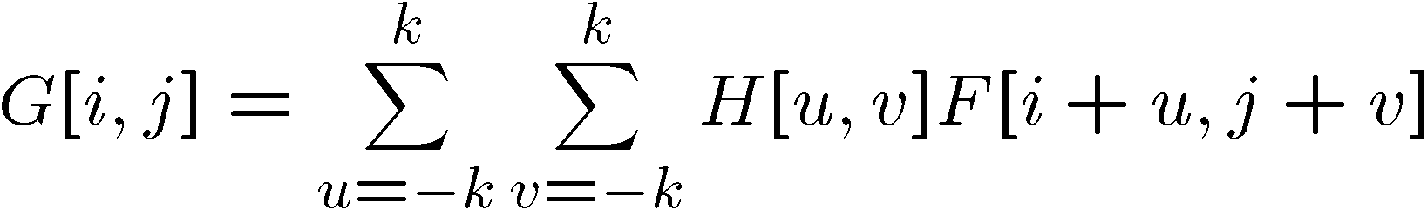

Cross-correlation
Let be the image, be the kernel (of size 2k+1 x 2k+1), and be the output image
Can think of as a “dot product” between local neighborhood and kernel for each pixel
This is called a cross-correlation operation:

Slide 13
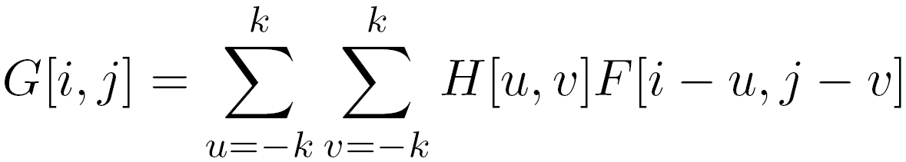

Convolution
Same as cross-correlation, except that the kernel is “flipped” (horizontally and vertically)
Convolution is commutative and associative
-F*G = G*F (commutative)
- F*(G*I) = (F*G)*I (associative)
This is called a convolution operation:
Notes:
F*G = G*F (commutative)
F*(G*I) = (F*G)*I (associative)

Slide 14

Mean filtering
1/9 for each pixel in H
0 | 0 | 0 | 0 | 0 | 0 | 0 | 0 | 0 | 0
0 | 0 | 0 | 0 | 0 | 0 | 0 | 0 | 0 | 0
0 | 0 | 0 | 90 | 90 | 90 | 90 | 90 | 0 | 0
0 | 0 | 0 | 90 | 90 | 90 | 90 | 90 | 0 | 0
0 | 0 | 0 | 90 | 90 | 90 | 90 | 90 | 0 | 0
0 | 0 | 0 | 90 | 0 | 90 | 90 | 90 | 0 | 0
0 | 0 | 0 | 90 | 90 | 90 | 90 | 90 | 0 | 0
0 | 0 | 0 | 0 | 0 | 0 | 0 | 0 | 0 | 0
0 | 0 | 90 | 0 | 0 | 0 | 0 | 0 | 0 | 0
0 | 0 | 0 | 0 | 0 | 0 | 0 | 0 | 0 | 0
 | 0 | 10 | 20 | 30 | 30 | 30 | 20 | 10
 | 0 | 20 | 40 | 60 | 60 | 60 | 40 | 20
 | 0 | 30 | 60 | 90 | 90 | 90 | 60 | 30
 | 0 | 30 | 50 | 80 | 80 | 90 | 60 | 30
 | 0 | 30 | 50 | 80 | 80 | 90 | 60 | 30
 | 0 | 20 | 30 | 50 | 50 | 60 | 40 | 20
 | 10 | 20 | 30 | 30 | 30 | 30 | 20 | 10
 | 10 | 10 | 10 | 0 | 0 | 0 | 0 | 0
*
=
1 | 1 | 1
1 | 1 | 1
1 | 1 | 1

Slide 15
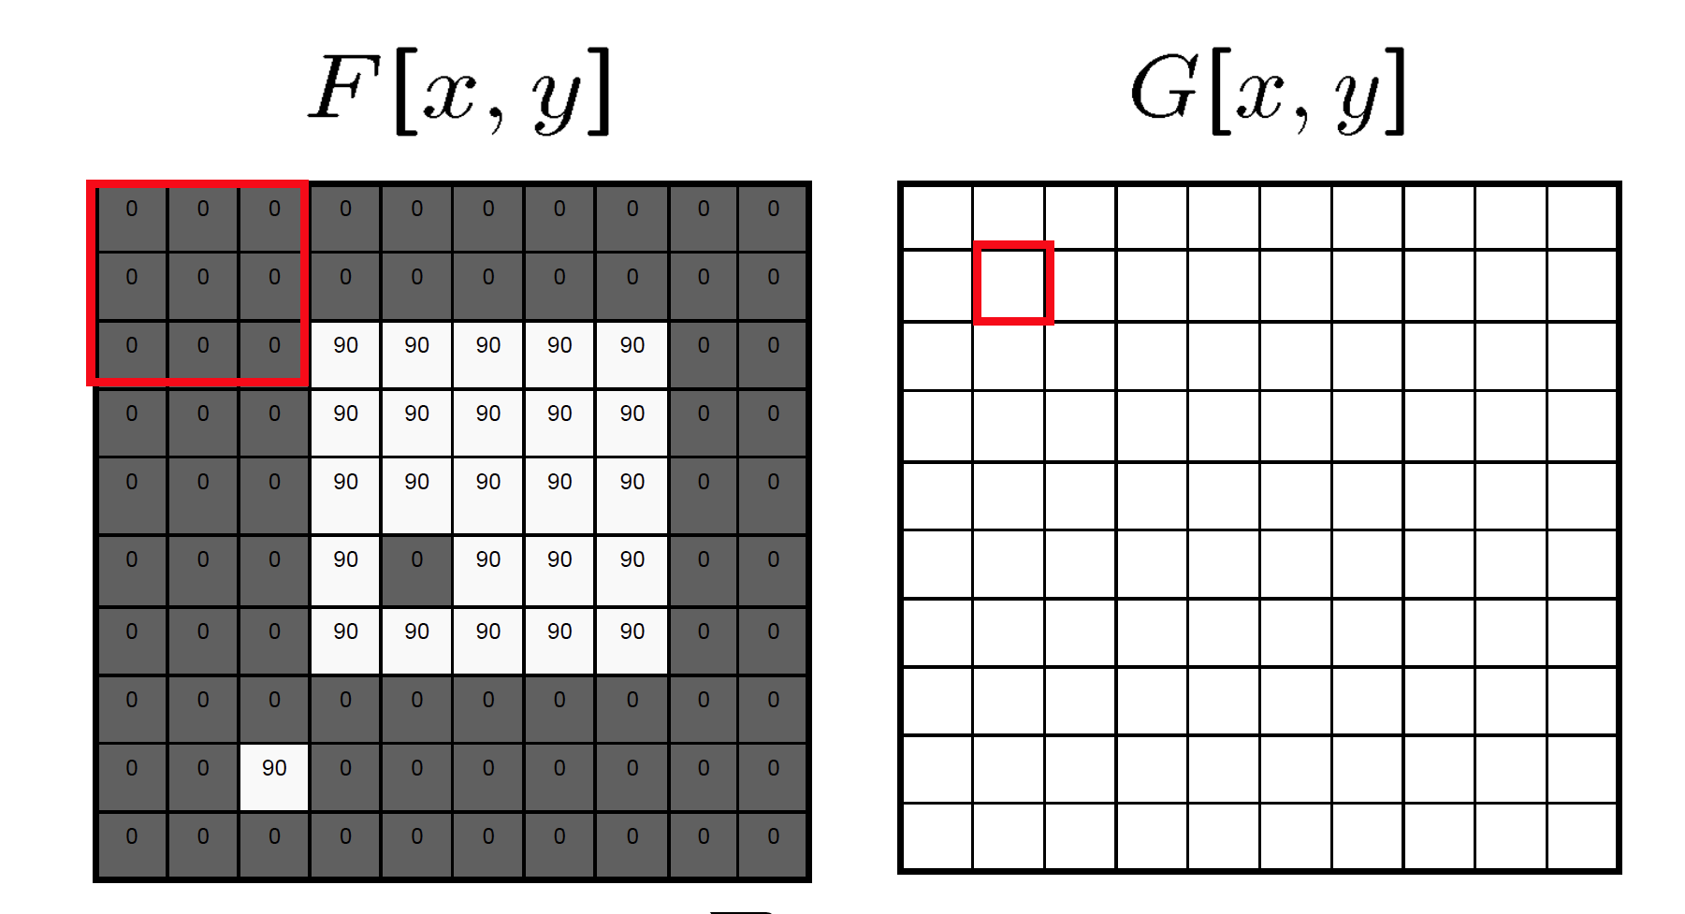
Mean filtering/Moving average

Slide 16
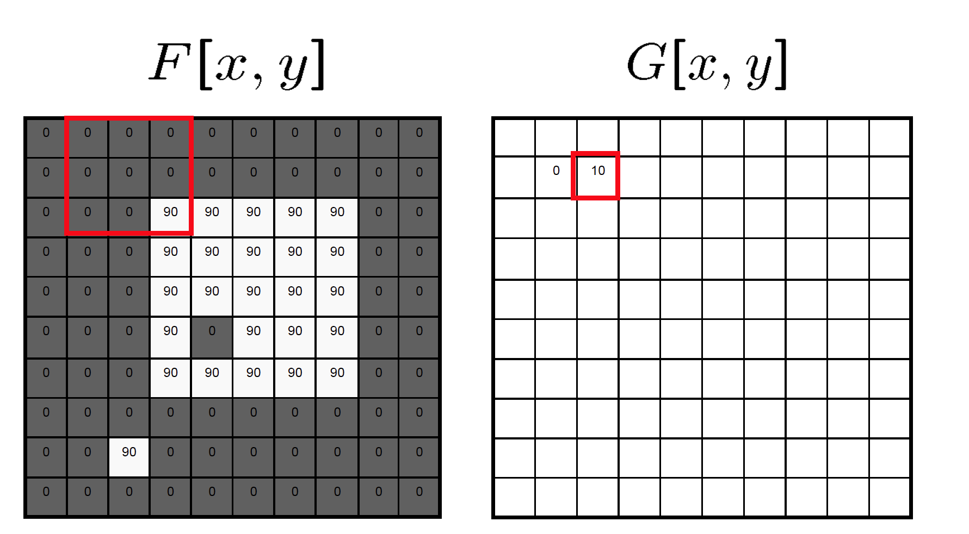
Mean filtering/Moving average

Slide 17

Mean filtering/Moving average

Slide 18
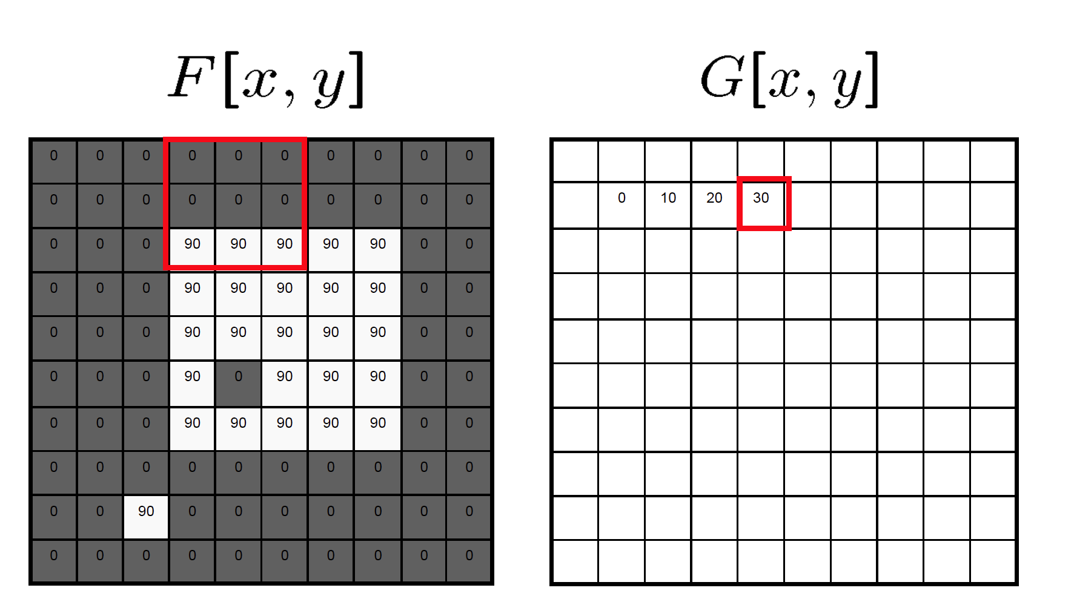
Mean filtering/Moving average

Slide 19
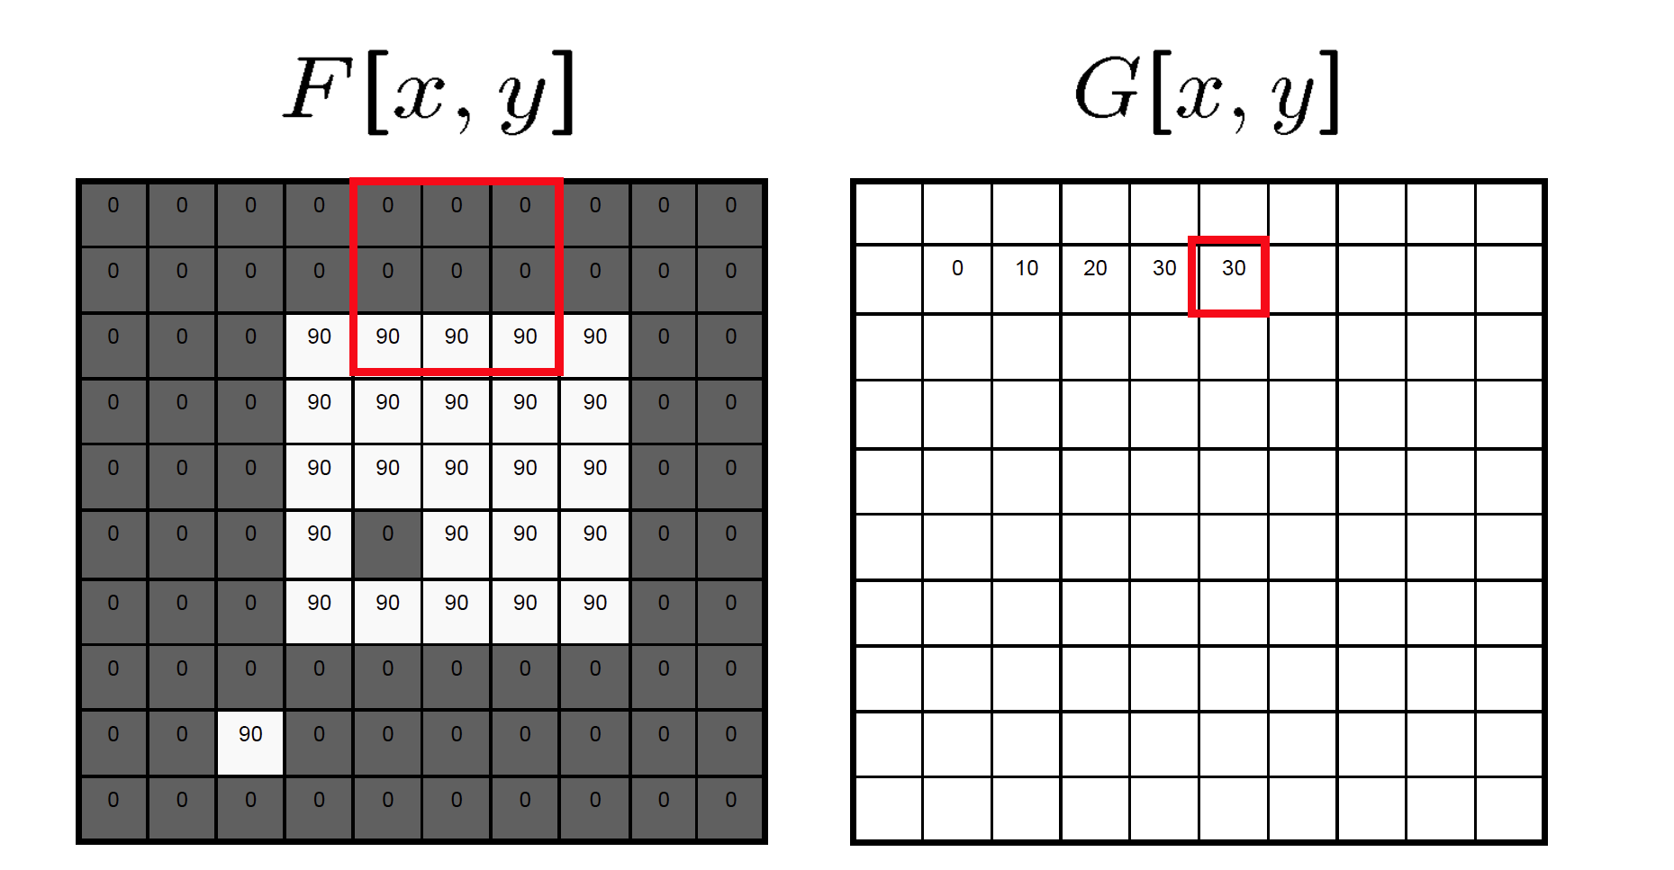
Mean filtering/Moving average

Slide 20
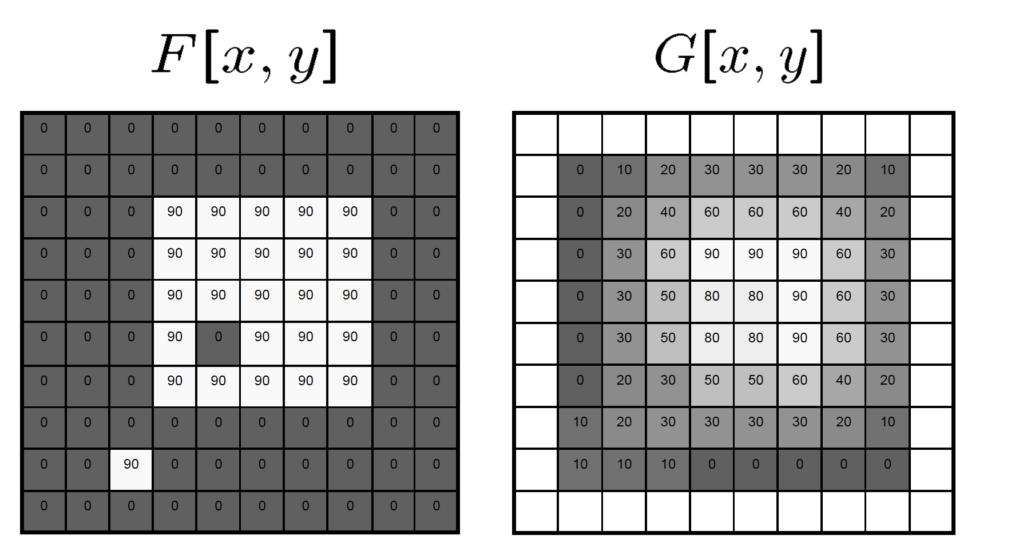
Mean filtering/Moving average

Slide 21
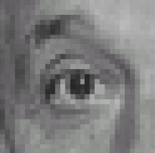
Linear filters: examples
*
0
0
0
=
0
1
0
0
0
0
Original
Identical image
Source: D. Lowe

Slide 22
Linear filters: examples
*
0
0
0
=
1
0
0
0
0
0
Original
Shifted left
By 1 pixel
Source: D. Lowe

Slide 23
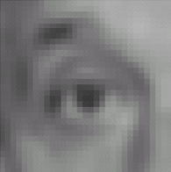

Linear filters: examples
*
1
1
1
=
1
1
1
1
1
1
Original
Blur (with a mean filter)
Source: D. Lowe

Slide 24
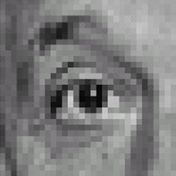



Linear filters: examples
*
0
0
0
-
1
1
1
=
0
2
0
1
1
1
0
0
0
1
1
1
Sharpening filter
Original
Source: D. Lowe

Slide 25
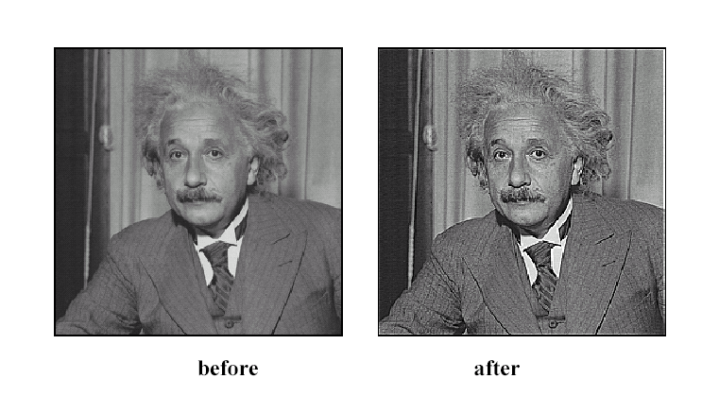
Sharpening
Source: D. Lowe

Slide 26
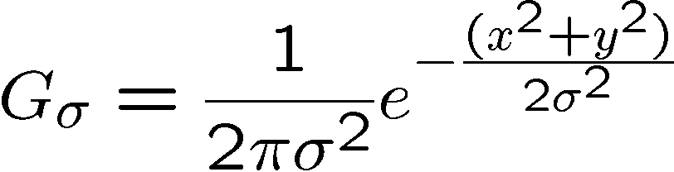
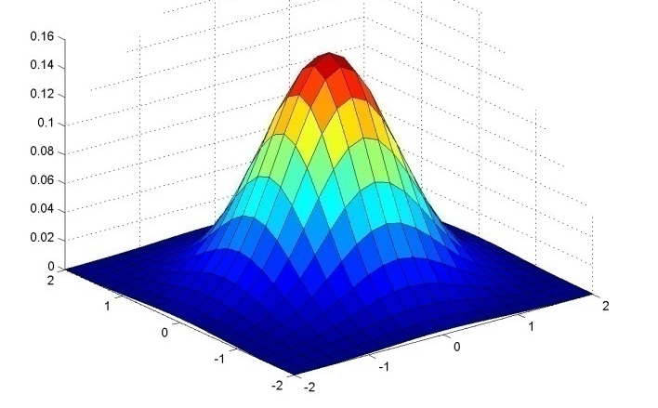
Gaussian Kernel
0.003 0.013 0.022 0.013 0.003
0.013 0.059 0.097 0.059 0.013
0.022 0.097 0.159 0.097 0.022
0.013 0.059 0.097 0.059 0.013
0.003 0.013 0.022 0.013 0.003
5 x 5, σ = 1
Constant factor at front makes volume sum to 1 (can be ignored, as we should re-normalize weights to sum to 1 in any case)
Source: C. Rasmussen

Slide 27
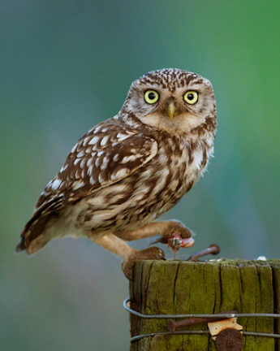
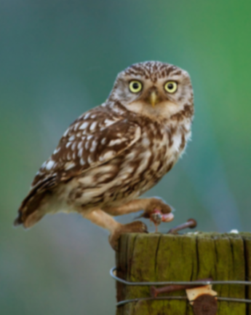








Gaussian filters
Increasing

Slide 28
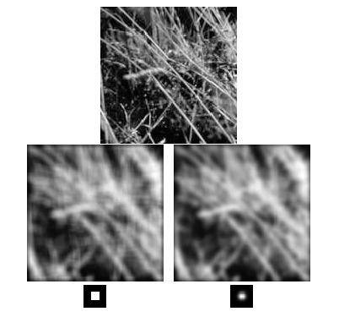
Mean vs. Gaussian filtering
Mean filter suppresses
high-frequency signal

Slide 29


Gaussian filter
Removes “high-frequency” components from the image (low-pass filter)
Convolution with self is another Gaussian
*
=
Source: K. Grauman

Slide 30
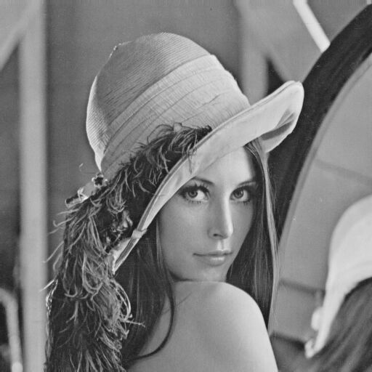
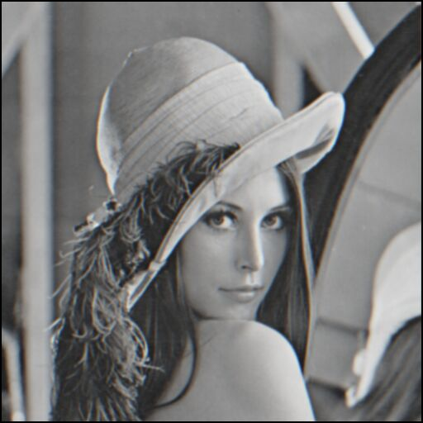
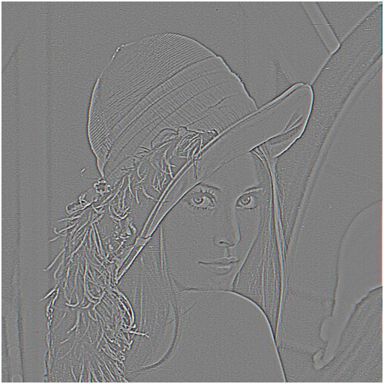

Sharpening revisited
What if taking away a blurred image?
–
=
original
smoothed (5x5)
detail
Let’s add it back:
+ α
=
original
detail
sharpened
Source: S. Lazebnik

Slide 31
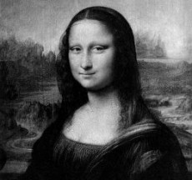
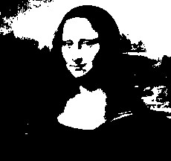

Filters: Thresholding

Slide 32
Reading Material
Szeliski, Chapter 3.1-3.2

